Slide 1

HR Award Questionnaire Survey Outputs and Subsequent Steps
Gabriela Vybíralová

Slide 2
WE GIVE OUR THANKS TO
all employees who spent time filling out the questionnaire,
all Working Group members,
Focus Group members and online interviews,
dr. Fučík and Mgr. Jáni for support.
Thanks to this cooperation, we had a chance to analyse your feedback to working and expert conditions at our faculty and prepare measures for improving in upcoming years

Slide 3
Thank you for filling out the questionnaire!
The questionnaire was addressed to:
211 researches and lecturers ……… returnability……….… 49,8%
168 Ph.D. students………………….... returnability………… 10,1%
91 administration employees………... returnability…………. 70,3%

Slide 4

Implemented steps to the HR Award
12/2019 - Endorsement of the Charter and Code
12/2019 - employee meeting and HR Award presentation
2/2020 - the questionnaire for researchers
3/2020 - the questionnaire for administration and technical employees
5-6/2020 - presentation of first GAP analysis outputs at the steering committee meeting
6/2020 - GAP analysis processing
8/2020 - Initial Action Plan Design and OTM-R
8-9/2020 - meetings of focus groups
10/2020 - presentation of results to faculty employees

Slide 5
The Working Group and Focus Groups
The Working Group cooperated on the creation of the GAP analysis, the Action Plan and the OTM-R document.
Focus Groups:
PLUSES: the faculty is family-friendly, excellent cooperation with the Office for Research and Project Support, central library, informal babysitting, no difference between job opportunities for males and females, joint meetings of employees, individual motivating approach of senior employees – especially when reducing work loads, flexibility of working hours, each department is original and has its own specific features
MINUSES: unsystematic work with Ph.D. students, low support for pedagogical activities, high administrative burden, fears of returning after maternity leave – setting workloads, lack of internal projects for parents, low involvement of women in the Scientific Board, no faculty kindergarten, unclear rules about teaching and science, great pressure on scientific performance, low support for new employees, little money for proofreading, insufficient feedback from senior employees, low systematization of selection procedure, low remuneration for lecturers

Slide 6
What areas are covered by HR Award?
Ethical
and
professional
aspects
HR Award
Recruitment
Education and
training
Working
conditions
and social
security

Slide 7
Ethical and professional principles – weaknesses of FSS
All documents are not available in English.
There is no system for training employees in the areas of ethical principles in research, intellectual property, handling personal data and the security of data use and storage, and other legal areas related to science and research.
There are no clear rules for approving research at FSS.
There is a lack of structured information and training related to project administration and strategic goals at the university and faculty level.
There is no comprehensive, easily navigable portal for searching for information.
There is a lack of a faculty strategy aimed at supporting the popularization of science and research, or the promotion of scientific research.
Little acquaintance of researchers with MU services, e.g. TTO MU, CERPEK MU, Centre for Language Education MU…
Insufficient support for employees with parental and caring responsibilities.
Employee evaluation – there is no system for administrative employees; there is no link to the further education of employees.
Strengthen the competencies of senior employees in relation to conducting evaluation interviews and giving feedback to employees.

Slide 8

From the questionnaires...
The available devices and technical equipment that the faculty offers to employees were assessed as satisfactory.
In particular, researchers lack the financial resources and appropriate collaborators for their research.
72% of researchers stated that research ethics is sufficiently provided for. 11% of respondents do not consider provision for the ethical aspects of scientific work sufficient. 17% of respondents said they did not know or could not answer the question.
Insufficient acquaintance with strategic documents is reported by 52% of respondents to the FSS survey.
44% of employees stated that their knowledge of faculty procedures for project management and administration, processing of accounting documents, and other matters was insufficient.
Only 18% of respondents have experience with TTO MU.
Sufficient support from the faculty in the area of public dissemination or commercial use of their work was mentioned by 25% of researchers, 37% of respondents stated that they did not feel support (support was either somewhat or entirely lacking) and 38% of respondents stated that they could not assess this area.
20% of respondents stated that they had not been evaluated in the last three years within the periodic evaluation system.
A quarter of respondents stated that they were not provided with sufficient feedback during the evaluation.
Men and women do not differ in their assessment of the relevance of the rating system.

Slide 9
Proposals for the AP regarding Ethical and Professional Principles:
Internationalization:
Integration of foreign workers and more frequent use of the English language. Translation of all faculty documents (guidelines, regulations, websites and others), searching for language course options for academic and administrative employees.
Creating a system for educating employees:
Regularly acquaint employees with the ethical principles and standards of MU and FSS.
Acquaint employees with information about intellectual property, the ethical principles of research, GDPR, secure use of online storage, MU services, and work procedures for the effective financial management of projects.
Educate senior employees in managerial skills and management style.
Acquaint mentors, supervisors of doctoral students, and new employees with procedures at FSS.
Professionalize project management and administration.
Develop a "Package of Regulations":
Draw up all the legal foundations and workflow systems into one clear map on the faculty website, which will clearly link users to current information for solving specific issues.
Establish internal transparent procedures and rules for dealing with discrimination cases and a complaints system.

Slide 10
Recruitment and selection of employees – weaknesses of FSS
The Regulations on Competitive Selection Procedures at Masaryk University will be updated and coordinated with the OTM-R policy.
There is a lack of faculty documents dealing with the recruitment and selection of new employees in selection procedures in accordance with the OTM-R policy.
Not all members of the selection committee are trained in OTM-R.
There is no systematic way of advertising vacancies on foreign job portals.
No career rules for positions R1–R4 have been drawn up and anchored.
New candidates are not informed about the career prospects within the offered position.
There is no definition, job description or career development in the PostDoc position.

Slide 11
From the questionnaires...
Researchers do not have comprehensive information on the process of recruiting research positions at their workplaces.
Only 25% of respondents consider the process of recruiting new employees to be comparable to the process abroad.
45% of employees answered that the process of recruiting new researchers attracts the interest of suitable candidates, 25% of respondents said this is not so (largely fails or entirely fails to attract interest), and 30% could not answer this question.
61% of researchers stated that the recruitment of new employees at the faculty is transparent, another 29% stated that the recruitment and selection of employees at the faculty is largely not or definitely not done transparently, and 10% of respondents could not answer the question.
According to respondents to the questionnaire survey, the following aspects are mostly taken into account in the selection procedure:
quantity and quality of scientific publications
quantity and degree of involvement in scientific research projects.
The value of foreign mobility was mapped in the questionnaire survey as sufficiently implemented, according to 85% of respondents

Slide 12
Proposals for the Recruitment and Selection Action Plan
Develop a faculty manual for the recruitment and selection of new employees which will reflect the OTM-R policy (it will define the rules and evaluation criteria for the selection procedure, include an evaluation of merits, etc.). The manual will be incorporated into the faculty regulations, will be publicly available on the FSS website and will have an English version.
Prepare a manual – Career Regulations for researchers at FSS in cooperation with a university-wide measure.
Create a system of advertising vacancies on job portals, including foreign portals.
Implement training for senior employees for qualified participation in selection committees.
Develop an online questionnaire to obtain feedback from applicants on the selection procedure.

Slide 13
Working conditions – weaknesses of FSS
Women reported less support and reduced provision of a research environment at FSS.
Employees had little acquaintance with the benefits of the faculty.
Administrative employees are not familiar with the MU Code of Ethics.
Insufficient support for employees with parental and caring responsibilities.
There is no link between setting the amount of financial evaluation and performance at individual levels R1–R4.
Low representation of women in higher research positions.
There is no position of any mentor at the faculty who would motivate researchers and contribute to reducing their uncertainty about their professional future.
There is no defined amount of pedagogical activities at workplaces for positions R1–R4 and Ph.D. students.
Insufficient offer for the development of pedagogical competencies and pedagogical programmes.
Insufficient acquaintance of faculty employees with the system when filing complaints.

Slide 14
From the questionnaires...
60% of respondents said they felt recognized as members of a professional group. The remaining 40% of respondents, on the other hand, said they did not feel this to be the case.
The results of the questionnaires showed a certain differentiation according to gender and age – following which were implemented focus groups.
According to the survey, 69% of men felt a recognized member of the professional group, but only 46% of women felt the same.
Two thirds of respondents said that their work environment incentivizes achieving scientific performance, more often men (71%) answered this to be the case than women (58%).
In contrast, most Ph.D. students (71%) answered that they did not perceive their work environment as stimulating.
The questionnaire survey shows that 86% of men and 73% of women perceive the possibility of finding a balance between working conditions in the workplace and personal and family life as satisfactory.
In the questionnaire survey, more than 60% of respondents stated that wage conditions are adequate to their expectations.
The survey also shows that the motivational evaluation system should be set up better, so that it would clearly show what performance is valued in the research positions R1–R4, and what performance is expected in these positions.

Slide 15
From the questionnaires...
The question “Do men and women have equal working conditions in the workplace?” was answered in the following way:
71% of women – yes, or largely yes, 23% of women – largely not, or definitely not
83% of men – yes, or rather yes, 11% of men – rather not, or definitely not
The question “Do men and women have equal employment opportunities in the workplace?” was answered in the following way:
63% of women – yes, or largely yes, 31% of women – largely not, or definitely not
80% of men – yes, or largely yes, 16% of men – largely not, or definitely not
64% of faculty employees stated that they have sufficient support in education and skills development.
85% of respondents stated that the value of foreign mobility was sufficiently implemented.
77% of respondents answered that their pedagogical performance is taken into account in the evaluation of employees, but 23% of respondents do not feel evaluated for their pedagogical performance.
50% of respondents stated that teaching prevents them from implementing research plans.
30% of respondents stated that they are overloaded with pedagogical tasks.
61% of respondents perceive a lack of familiarity with the complaint process.

Slide 16
Proposals for the AP regarding working conditions
Develop a "Package of Regulations":
Draw up the legal foundations and workflow systems into one clear map on the faculty website and link it to current information for solutions
to specific issues.
Establish internal transparent procedures and rules for dealing with discrimination cases.
Support for new employees:
Acquaint new employees with important documents that facilitate orientation in the processes and internal regulations of MU and FSS, and that facilitate work activities.
Acquaint researchers with the field of commercialization and access to research results.
Provide adequate support for young researchers or new employees.
Internal communication:
Organize regular meetings of employees and acquaint them with strategic plans, new methodologies, projects, benefits, etc.
Create a portal offering further training and development for employees.
Create a faculty system for acquainting employees with scientific outputs occurring at FSS.
Promotion:
Use modern tools to promote the results of FSS researchers to the public.
Acquaint FSS employees with MU workplaces.

Slide 17
Development and training – weaknesses of FSS
There is no system of work with beginning researchers.
There is no position of mentor who would help employees at the beginning of their career at FSS.
There is no description of the role of mentor and its competencies.
There is no manual for Ph.D. students.
There is no system of training for senior employees in the field of management or human resources management.
Insufficient time flexibility of supervisors.
Lower promotion of educational programmes for Ph.D. students and researchers in positions R1–R4.
There is no comprehensive system of further education for researchers at all levels R1–R4 or Ph.D. students.

Slide 18
From the questionnaires...
71% of respondents said they knew they had the opportunity to use regular contact with their supervisor, this view was shared by researchers and scientists at the R1–R4 level.
48% of respondents make full use of the possibility to maintain contact with their supervisor.
54% of respondents stated that they are constantly striving to develop their abilities, knowledge and skills at all stages of their careers.
71% of respondents consider the possibility of regular contact with their supervisor sufficient, this view was shared by researchers and scientists at the R1–R4 level.

Slide 19
Proposals for the AP regarding development and training
Creating a system for mentoring:
Establish the position of mentor, name the position and specify it.
Train mentors.
Create a manual for mentors, describe the work activities of a mentor.
Monitor the quality of supervisors and their communication with students.
Implement restrictions on the number of supervised doctoral students and reduce the overloading of supervisors.
Create a manual for Ph.D. students.
Revise and supplement the possibilities of further education for all researchers and Ph.D. students.

Slide 20
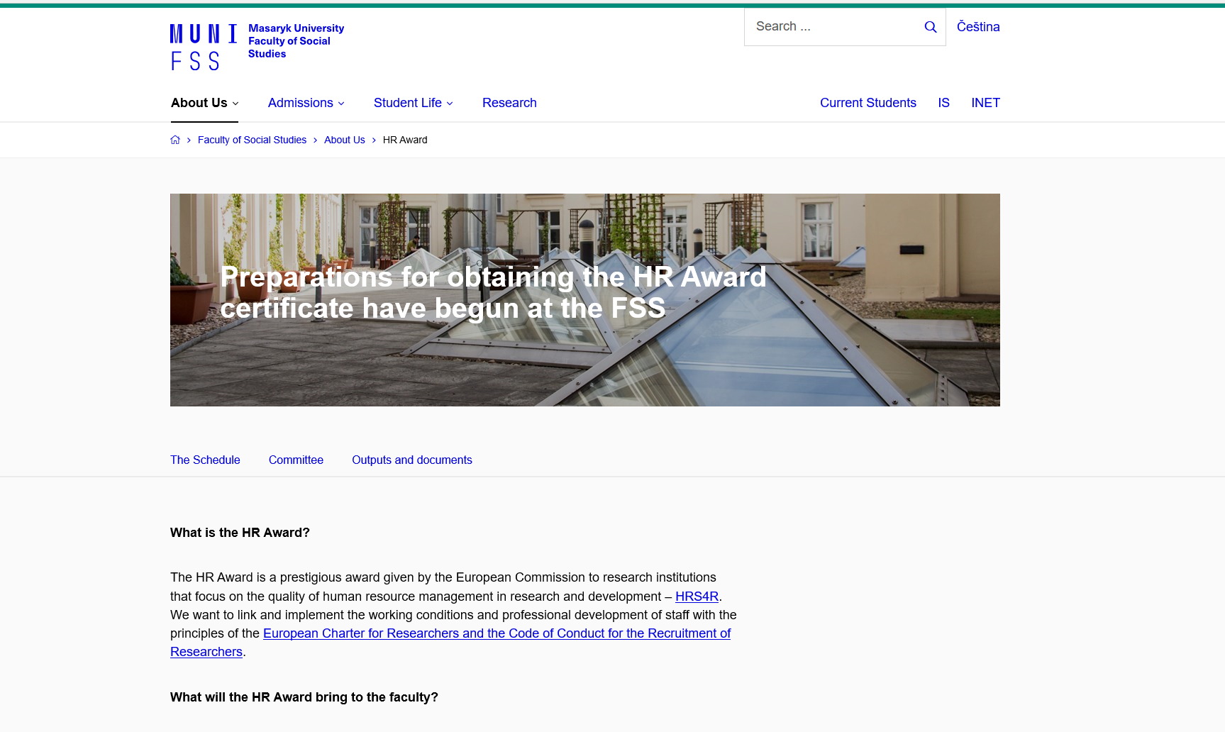
Up-to-date information about HR Award:
https://www.fss.muni.cz/en/faculty-of-social-studies/about-us/hr-award

Slide 21
Thank you for your attention
Gabriela Vybíralová – HR manager and Team HR Award
E-mail: vybiralova@fss.muni.cz

